Slide 1

Basics of computer and Programming
Part 1
Date:

Slide 2
What is a computer ?
A computer is an electronic device that will take input from the user, process it, and give results or respond as per the user. The computer is a programmable computational device.
The components of a computer are:
Input Unit
Central Processing Unit(CPU)
Output Unit
Performing all these operations the CPU has 3 sub-units:
Arithmetic and Logical Unit
Control Unit
Memory Unit

Slide 3
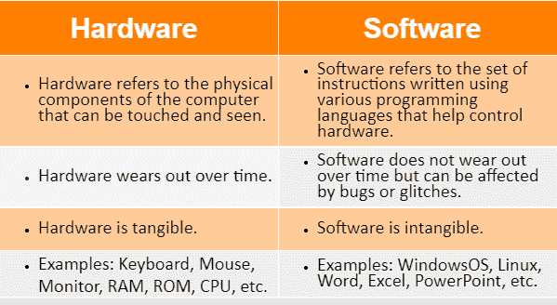
What is Hardware and software ?

Slide 4
Arithmetic and Logical Unit,
Arithmetic and Logical Unit (ALU):
The Arithmetic and Logical Unit is a fundamental component of a computer's central processing unit (CPU). It is responsible for performing arithmetic operations (such as addition, subtraction, multiplication, and division) and logical operations (such as comparisons and bitwise operations). The ALU processes numerical and logical data, executing the instructions provided by the computer program.

Slide 5
Control Unit
Control Unit:
The Control Unit is another crucial component of the CPU that manages and coordinates the operations of the entire processor. It fetches instructions from memory, decodes them to understand the required operations, and then directs the flow of data between different components, including the ALU, memory, and input/output devices. The Control Unit ensures that instructions are executed in the correct sequence and at the right time, enabling the proper functioning of the computer system.

Slide 6
Memory Unit
Memory Unit:
The Memory Unit, often referred to as RAM (Random Access Memory), is where the computer stores data and instructions temporarily during program execution. It provides fast access to data for the CPU and is used to store both program instructions and the data being processed. Memory is classified into two main types: primary memory (RAM) and secondary memory (like hard drives or SSDs). Primary memory is volatile, meaning it loses its contents when the power is turned off, while secondary memory retains data even when the power is off. The Memory Unit plays a crucial role in the overall speed and efficiency of a computer system.

Slide 7
Input/Output Unit (I/O Unit)
Input/Output Unit (I/O Unit):
The Input/Output Unit, often abbreviated as I/O Unit, is responsible for managing the communication between the computer system and external devices. Its primary function is to facilitate the transfer of data between the central processing unit (CPU) and peripherals, such as keyboards, mice, displays, printers, and storage devices. The I/O Unit interprets commands from the CPU, initiates data transfers, and handles the conversion between the internal format of the computer and the format suitable for external devices. Input devices provide data to the computer, while output devices display or store the results of computation. The I/O Unit ensures smooth interaction between the computer and its external environment.

Slide 8
What is coding ?
Coding is a list of step-by-step instructions that get computers to do what you want them to do. Coding makes it possible for us to create computer software, games, apps and websites.

Slide 9
What is programming ?
Programming refers to a technological process for telling a computer which tasks to perform in order to solve problems. You can think of programming as a collaboration between humans and computers, in which humans create instructions for a computer to follow (code) in a language computers can understand.

Slide 10
What is compiler ?
A compiler is a special program that translates a programming language's source code into machine code, bytecode or another programming language.

Slide 11
What is interpreter ?
An interpreter is a program that directly executes the instructions in a high-level language, without converting it into machine code. In programming, we can execute a program in two ways. Firstly, through compilation and secondly, through an interpreter. The common way is to use a compiler.

Slide 12
What is Algorithm ?
The word Algorithm means ” A set of finite rules or instructions to be followed in calculations or other problem-solving operations ”
Algorithm refers to a sequence of finite steps to solve a particular problem.
The main characteristics of an algorithm are well-defined inputs, well-defined outputs, feasibility, finiteness, unambiguity, definitiveness, and language independence.

Slide 13
Why is learning programming important ?
Learning programming can help you develop problem-solving skills, open up career opportunities, foster creativity, automate tasks, and promote personal development.

Slide 14
Is programming easy or Hard ?
Fundamental skills
Daily practice

Slide 15
What programming should I learn ?
Start with basic languages
Python
Java
JavaScript
C and C++

Slide 16
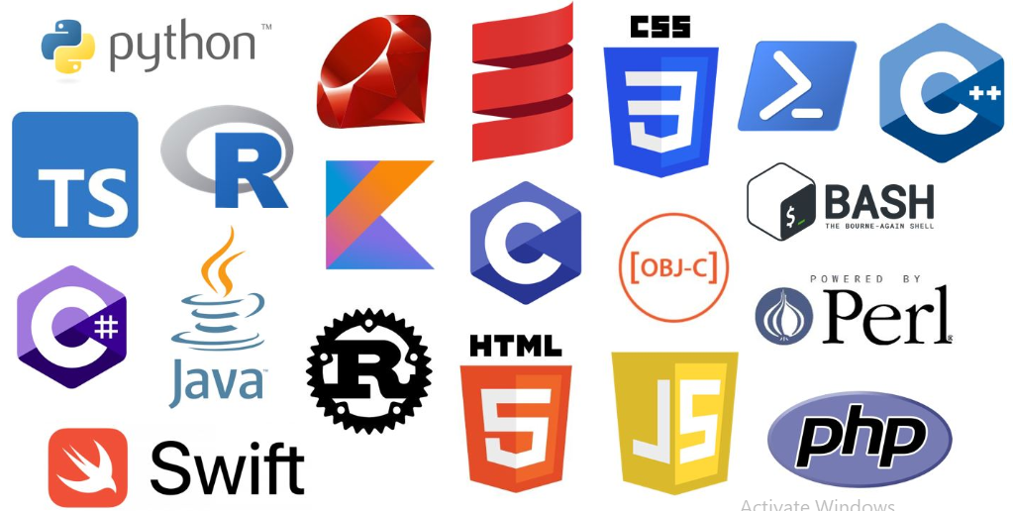
Some of the programming languages ?

Slide 17
How can I learn programming ?

Slide 18
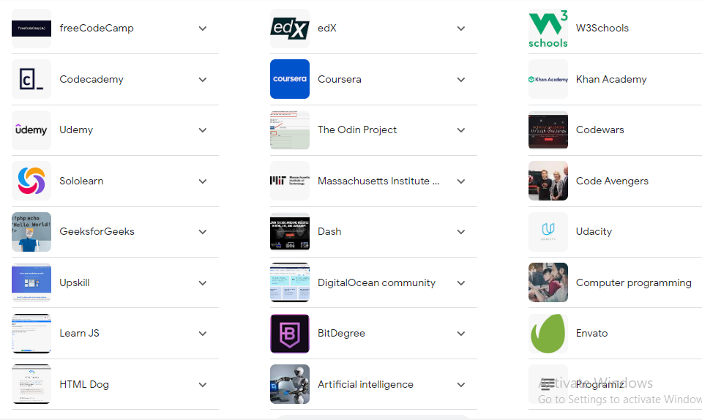
Platforms to learn Programming ?
Geeks for Geeks

Slide 19
Any queries ? Thank you
Contact: +91 8940940853
Instagram :@captech2024
Facebook: Captech Ghm
Email: captech2024@gmail.com

